Slide 1
18CSC202J - OBJECT ORIENTED DESIGN AND PROGRAMMING
Session 6
Topic : Streams and Files

Slide 2
Learning Objectives
C++ I/O streams.
Reading and writing sequential files.
Reading and writing random access files.
CPSC 231 D.H. C++ File Processing

Slide 3
C++ Files and Streams
C++ views each files as a sequence of bytes.
Each file ends with an end-of-file marker.
When a file is opened, an object is created and a stream is associated with the object.
To perform file processing in C++, the header files <iostream.h> and <fstream.h> must be included.
<fstream.> includes <ifstream> and <ofstream>
CPSC 231 D.H. C++ File Processing

Slide 4
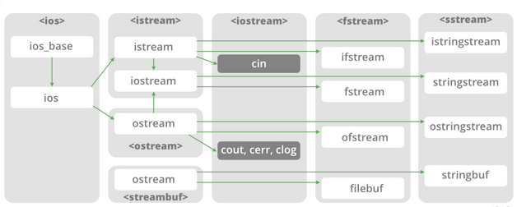

Slide 5
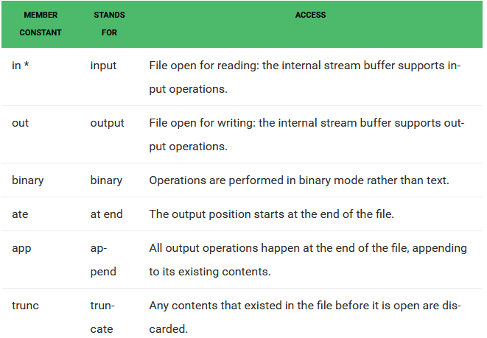

Slide 6
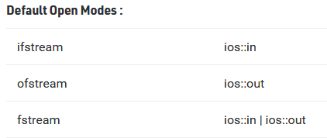

Slide 7
Creating a sequential file
// Fig. 14.4: fig14_04.cpp D&D p.708
// Create a sequential file
#include <iostream.h>
#include <fstream.h>
#include <stdlib.h>
int main()
{
// ofstream constructor opens file
ofstream outClientFile( "clients.dat", ios::out );
if ( !outClientFile ) { // overloaded ! operator
cerr << "File could not be opened" << endl;
exit( 1 ); // prototype in stdlib.h
}

Slide 8
Sequential file
cout << "Enter the account, name, and balance.\n"
<< "Enter end-of-file to end input.\n? ";
int account;
char name[ 30 ];
float balance;
while ( cin >> account >> name >> balance ) {
outClientFile << account << ' ' << name
<< ' ' << balance << '\n';
cout << "? ";
}
return 0; // ofstream destructor closes file
}

Slide 9
How to open a file in C++ ?
Ofstream outClientFile(“clients.dat”, ios:out)
OR
Ofstream outClientFile;
outClientFile.open(“clients.dat”, ios:out)

Slide 10
File Open Modes
ios:: app - (append) write all output to the end of file
ios:: ate - data can be written anywhere in the file
ios:: binary - read/write data in binary format
ios:: in - (input) open a file for input
ios::out - (output) open afile for output
ios: trunc -(truncate) discard the files’ contents if
it exists

Slide 11
File Open Modes contd…..
ios:nocreate - if the file does NOT exists, the open operation fails
ios:noreplace - if the file exists, the open operation fails

Slide 12
How to close a file in C++?
The file is closed implicitly when a destructor for the corresponding object is called
OR
by using member function close:
outClientFile.close();

Slide 13
Reading and printing a sequential file
// Reading and printing a sequential file
#include <iostream.h>
#include <fstream.h>
#include <iomanip.h>
#include <stdlib.h>
void outputLine( int, const char *, double );
int main()
{
// ifstream constructor opens the file
ifstream inClientFile( "clients.dat", ios::in );
if ( !inClientFile ) {
cerr << "File could not be opened\n";
exit( 1 );
}

Slide 14
int account;
char name[ 30 ];
double balance;
cout << setiosflags( ios::left ) << setw( 10 ) << "Account"
<< setw( 13 ) << "Name" << "Balance\n";
while ( inClientFile >> account >> name >> balance )
outputLine( account, name, balance );
return 0; // ifstream destructor closes the file
}
void outputLine( int acct, const char *name, double bal )
{
cout << setiosflags( ios::left ) << setw( 10 ) << acct
<< setw( 13 ) << name << setw( 7 ) << setprecision( 2 )
<< resetiosflags( ios::left )
<< setiosflags( ios::fixed | ios::showpoint )
<< bal << '\n';
}

Slide 15
File position pointer
<istream> and <ostream> classes provide member functions for repositioning the file pointer (the byte number of the next byte in the file to be read or to be written.)
These member functions are:
seekg (seek get) for istream class
seekp (seek put) for ostream class

Slide 16
Examples of moving a file pointer
inClientFile.seekg(0) - repositions the file get pointer to the beginning of the file
inClientFile.seekg(n, ios:beg) - repositions the file get pointer to the n-th byte of the file
inClientFile.seekg(m, ios:end) -repositions the file get pointer to the m-th byte from the end of file
nClientFile.seekg(0, ios:end) - repositions the file get pointer to the end of the file
The same operations can be performed with <ostream> function member seekp.

Slide 17
Updating a sequential file
Data that is formatted and written to a sequential file cannot be modified easily without the risk of destroying other data in the file.
If we want to modify a record of data, the new data may be longer than the old one and it could overwrite parts of the record following it.

Slide 18
Problems with sequential files
Sequential files are inappropriate for so-called “instant access” applications in which a particular record of information must be located immediately.
These applications include banking systems, point-of-sale systems, airline reservation systems, (or any data-base system.)

Slide 19
Random access files
Instant access is possible with random access files.
Individual records of a random access file can be accessed directly (and quickly) without searching many other records.

Slide 20
Example of a Program that Creates a Random Access File
// Fig. 14.11: clntdata.h
// Definition of struct clientData used in
// Figs. 14.11, 14.12, 14.14 and 14.15.
#ifndef CLNTDATA_H
#define CLNTDATA_H
struct clientData {
int accountNumber;
char lastName[ 15 ];
char firstName[ 10 ];
float balance;
};
#endif

Slide 21
Creating a random access file
// Creating a randomly accessed file sequentially
#include <iostream.h>
#include <fstream.h>
#include <stdlib.h>
#include "clntdata.h"
int main()
{
ofstream outCredit( "credit1.dat", ios::out);
if ( !outCredit ) {
cerr << "File could not be opened." << endl;
exit( 1 );
}

Slide 22
clientData blankClient = { 0, "", "", 0.0 }; for ( int i = 0; i < 100; i++ ) outCredit.write
(reinterpret_cast<const char *>( &blankClient ), sizeof( clientData ) ); return 0;
}

Slide 23
<ostream> membEr function write
The <ostream> member function write outputs a fixed number of bytes beginning at a specific location in memory to the specific stream. When the stream is associated with a file, the data is written beginning at the location in the file specified by the “put” file pointer.

Slide 24
Writing data randomly to a random file
#include <iostream.h>
#include <fstream.h>
#include <stdlib.h>
#include "clntdata.h"
int main()
{
ofstream outCredit( "credit.dat", ios::ate );
if ( !outCredit ) {
cerr << "File could not be opened." << endl;
exit( 1 );
}

Slide 25
cout << "Enter account number "<< "(1 to 100, 0 to end input)\n? ";
clientData client;
cin >> client.accountNumber;
while ( client.accountNumber > 0 && client.accountNumber <= 100 )
{
cout << "Enter lastname, firstname, balance\n? ";
cin >> client.lastName >> client.firstName>> client.balance;

Slide 26
outCredit.seekp( ( client.accountNumber - 1 ) *sizeof( clientData ) );
outCredit.write(
reinterpret_cast<const char *>( &client ),
sizeof( clientData ) );
cout << "Enter account number\n? ";
cin >> client.accountNumber;
}
return 0;
}

Slide 27
Reading data from a random file
#include <iostream.h>
#include <iomanip.h>
#include <fstream.h>
#include <stdlib.h>
#include "clntdata.h"
void outputLine( ostream&, const clientData & );
int main()
{
ifstream inCredit( "credit.dat", ios::in );
if ( !inCredit ) {
cerr << "File could not be opened." << endl;
exit( 1 );
}

Slide 28
cout << setiosflags( ios::left ) << setw( 10 ) << "Account"<< setw( 16 ) << "Last Name" << setw( 11 )
<< "First Name" << resetiosflags( ios::left )<< setw( 10 ) << "Balance" << endl;
clientData client;
inCredit.read( reinterpret_cast<char *>( &client ),
sizeof( clientData ) );
CPSC 231 D.H. C++ File Processing

Slide 29
while ( inCredit && !inCredit.eof() ) {
if ( client.accountNumber != 0 )
outputLine( cout, client );
inCredit.read( reinterpret_cast<char *>( &client ),
sizeof( clientData ) );
}
return 0;
}

Slide 30
void outputLine( ostream &output, const clientData &c )
{
output << setiosflags( ios::left ) << setw( 10 )<< c.accountNumber << setw( 16 ) << c.lastName
<< setw( 11 ) << c.firstName << setw( 10 )<< setprecision( 2 ) << resetiosflags( ios::left )
<< setiosflags( ios::fixed | ios::showpoint )<< c.balance << '\n';
}
CPSC 231 D.H. C++ File Processing

Slide 31
The <istream> function read
inCredit.read (reinterpret_cast<char *>(&client),sizeof(clientData));
The <istream> function inputs a specified (by sizeof(clientData)) number of bytes from the current position of the specified stream into an object.

